Slide 1

Department of Scientific Computing, Modelling and Simulation Savitribai Phule Pune University
Academic Year: 2024–2025
Title: Comparative Study on Object Detection Using CNN And YOLO
Under the Guidance of
Dr. Kaveri Kale
Name: Bhushan Zade Roll No: MS2421

Slide 2
Comparative Study of Object Detection using Faster R-CNN and YOLO
Objective:
To compare accuracy vs speed in object detection
Evaluate two-stage vs one-stage detectors
Models Used:
Faster R-CNN (CNN-based, two-stage)
YOLOv5 (one-stage, real-time)
Dataset: Pascal VOC 2007 (20 classes)

Slide 3
Models Overview
Faster R-CNN (Two-Stage)
Region Proposal Network (RPN)
Accurate bounding box refinement
High accuracy, slow inference
YOLO (One-Stage)
Single forward pass
Predicts boxes + classes together
Designed for real-time detection

Slide 4
Experimental Results & Comparison
Metric | Faster R-CNN | YOLOv5
Precision | High | High
mAP@0.5 | Higher | Slightly Lower
Inference Time | 0.136 s | 0.045 s
FPS | 7.35 | 22.15
Real-Time | No | Yes

Slide 5
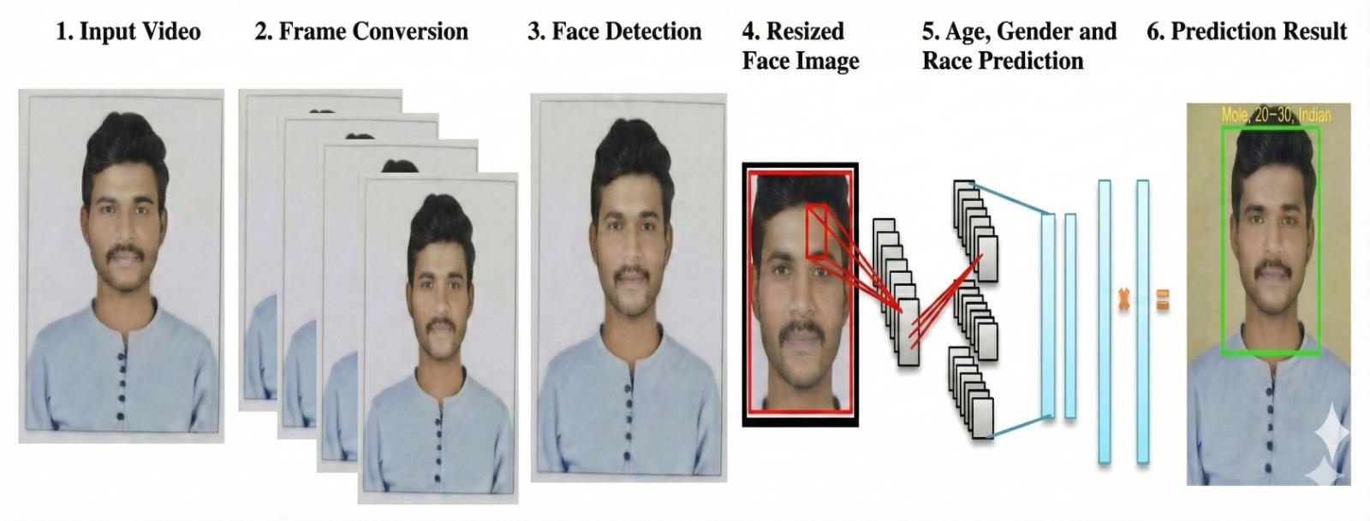
Conclusion
Faster R-CNN: Best for offline, accuracy-focused tasks
YOLO: Best for real-time applications
Final Insight :
There is a clear trade-off between accuracy and speed.
YOLO provides the best balance for real-world systems.
Future Scope :

